Slide 1


Social Buzz is Fast growing technology unicorn
That need to adapt quickly to it’s global scale.
Accenture has begun a 3 month POC focusing on these task:
1) An audit of Social Buzz’s big data practice
2) Recommendations for a successful IPO
3) Analysis to find Social Buzz’s top most 5 popular categories
Project Recap

Slide 2

Over 100000 posts per day
36500000 pieces of content per year!
But how to capitalize on when there is so much?
Analysis to find Social Buzz’s top 5 popular
categories
Problem

Slide 3




Andrew Fleming
Chief Technical Architect
The Analytics team
Marcus Rompton
Senior Principle
Onkar Kulkarni
Data Analyst

Slide 4

Data Understanding
Process
1
Data Cleaning
2
Data Modelling
3
Data Analysis
4
5
Business Insights

Slide 5
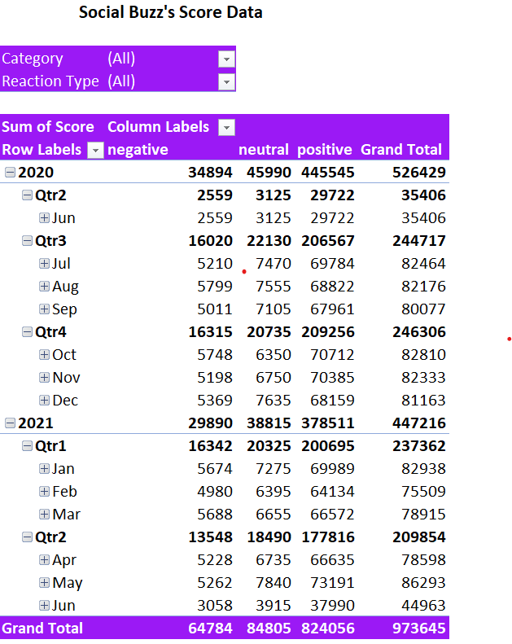

Insights
Sub Category | Score
Studying | 54269
healthy eating | 69339
technology | 68738
food | 66676
cooking | 64756
dogs | 52511
soccer | 57783
public speaking | 49264
science | 71168
tennis | 50339
travel | 64880
fitness | 55323
education | 57436
veganism | 49619
Animals | 74965
culture | 66579

Slide 6
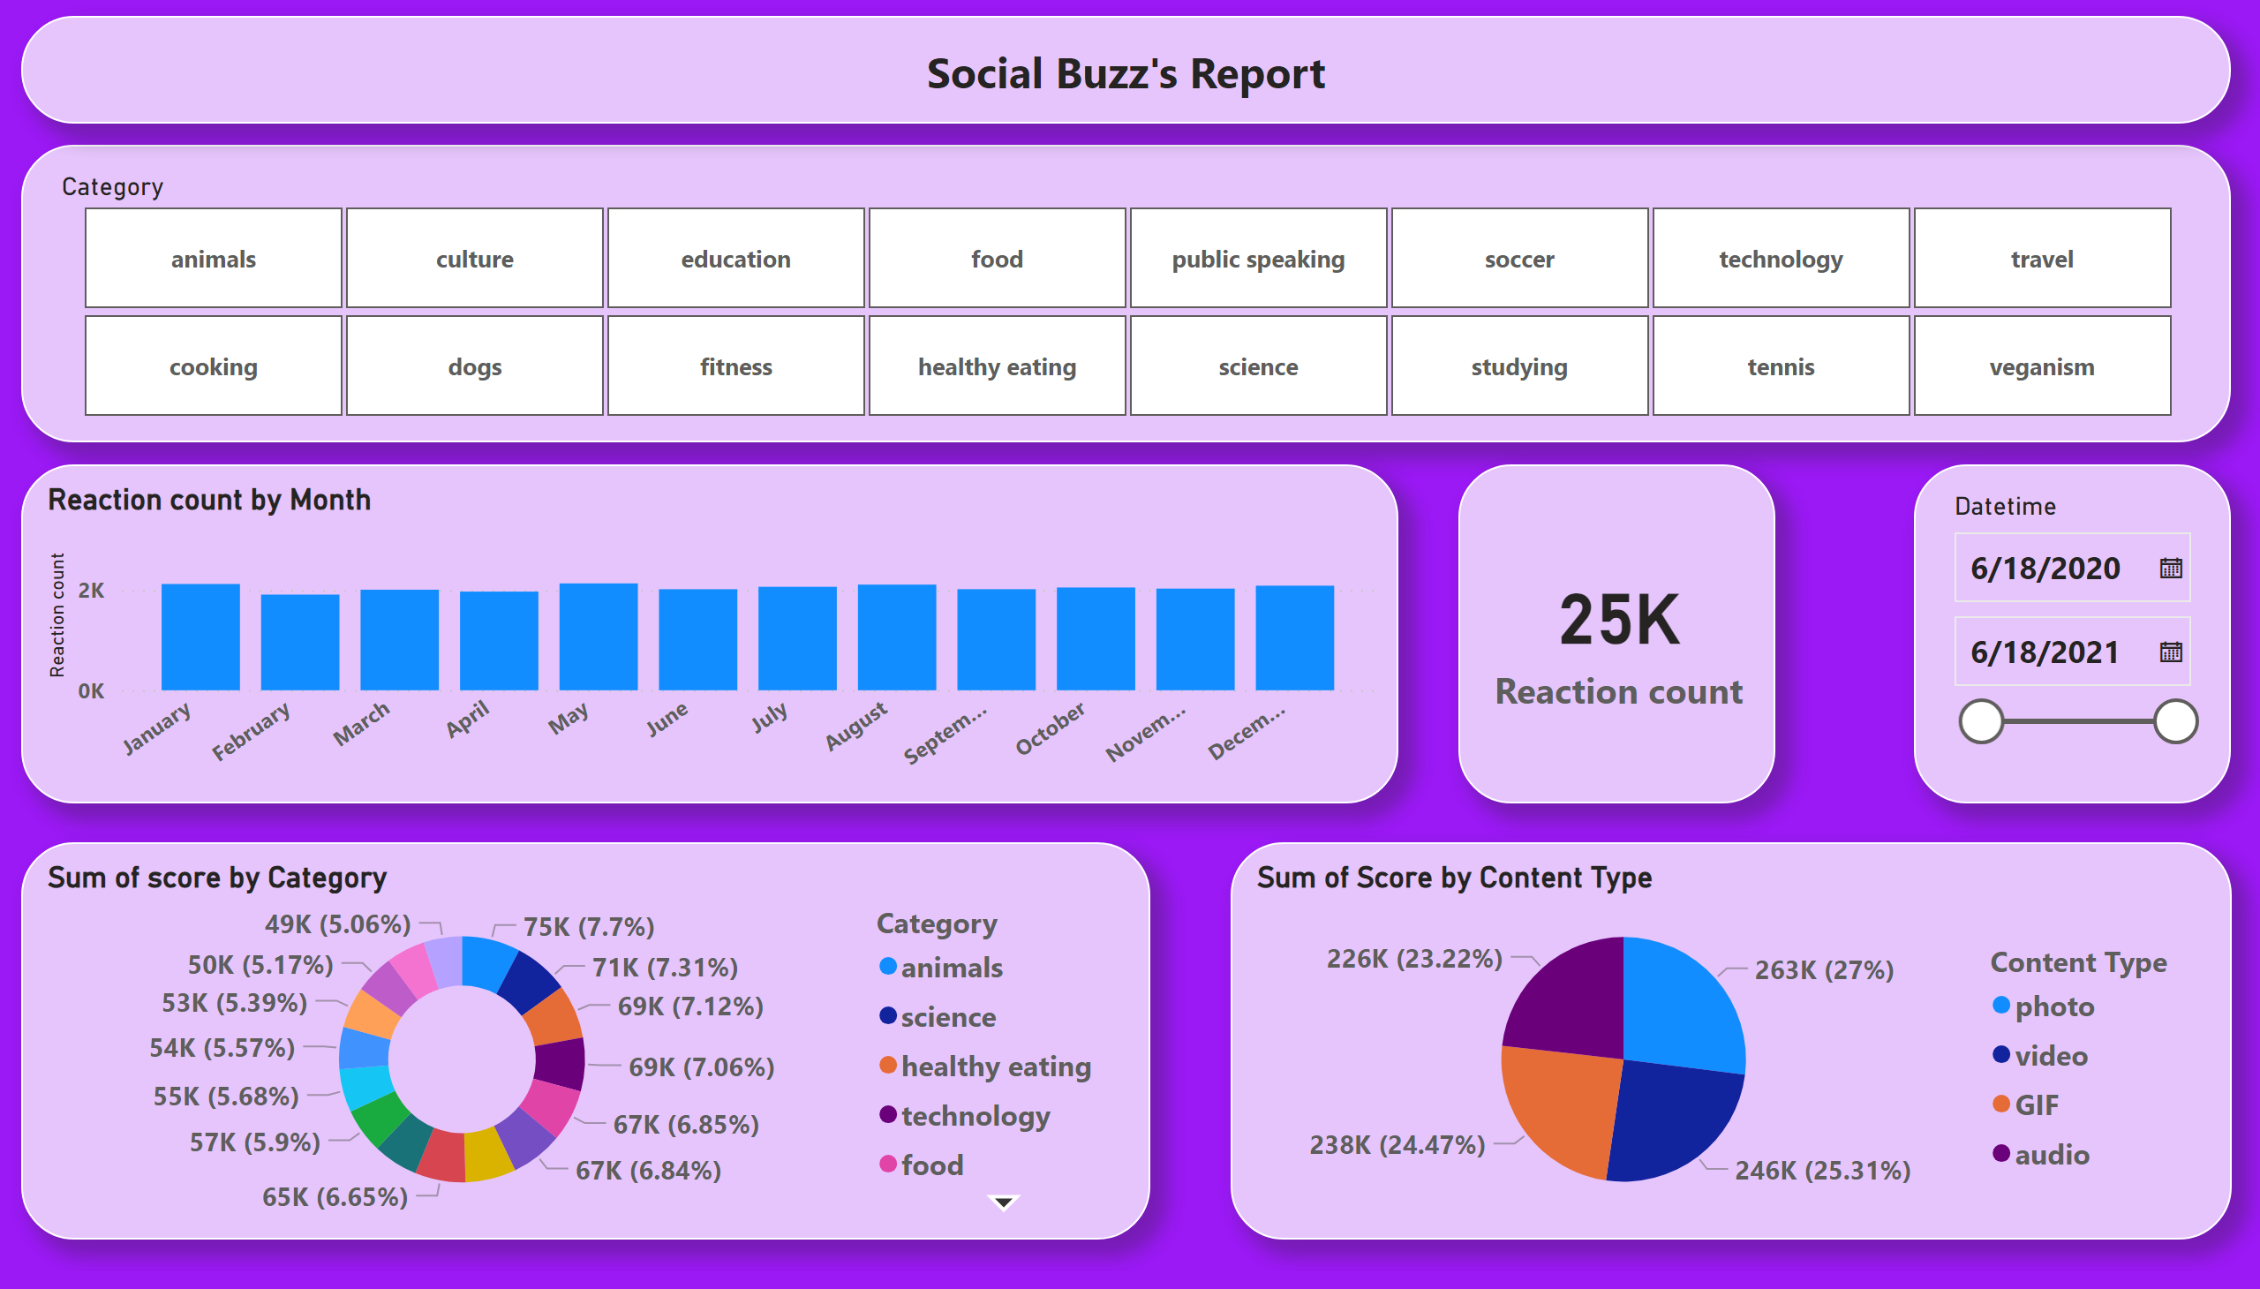
Report
Notes:
slicer
No alt text provided
donutChart
No alt text provided
clusteredColumnChart
No alt text provided
pieChart
No alt text provided
card
No alt text provided
slicer
No alt text provided
textbox
No alt text provided

Slide 7

ANALYSIS
Animal and Science are the two most popular Categories of content, showing that people enjoy “real-life” and “factual” content the most
INSIGHT
Food is a common theme with the top 5 categories with “Healthy Eating” ranking the highest. This may give an indication to the audience within your user base. You could use this insight to create a campaign and work with healthy eating brands a campaign and work with healthy eating brands to boost user engagement.
NEXT STEPS
This ad-hoc analysis is insightful, but it’s time to take this analysis into large scale production for real-time understanding of your business.
Summary
.

Slide 8
Thank you!
ANY QUESTIONS?

